Slide 1
Middle School Week Three

Slide 2
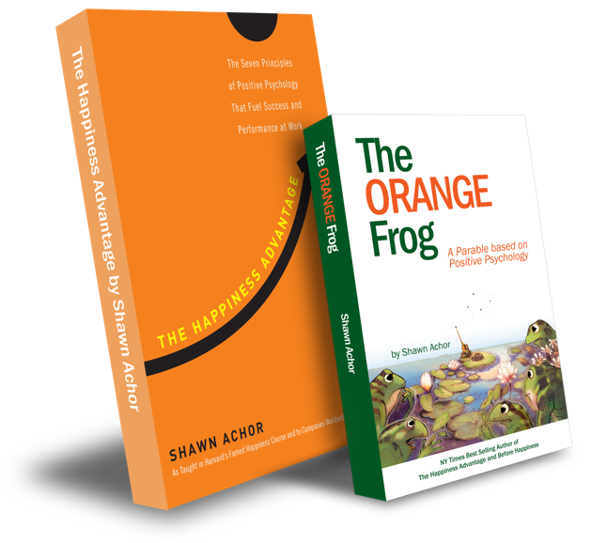
The Happiness Advantage
and
The Orange Frog
By Shawn Achor

Slide 3
The Orange Frog
Learning Objective:
I can be helpful
I will discuss the importance of being helpful and finding ways that are helpful to others
Notes:
Standard:
Essential Concept and/or Skill: Communicate and work productively with others emphasizing collaboration and cultural awareness to produce quality work.
Interact positively as a team member.
Cooperate with others in a group setting.
Generate ideas with group members.
Are active listeners.
Read and understand information in a variety of forms.
Express ideas.
Skill:
Active listening, express ideas
Allow Spark to read pages 13-18 for the students or read to them.
https://www.orangefrogschools.com/elementary/ofkidsbook

Slide 4
Skills
Interact positively as a team member.
Cooperate with others in a group setting.
Generate ideas with group members.
Are active listeners.
Read and understand information in a variety of forms.
Express ideas.

Slide 5
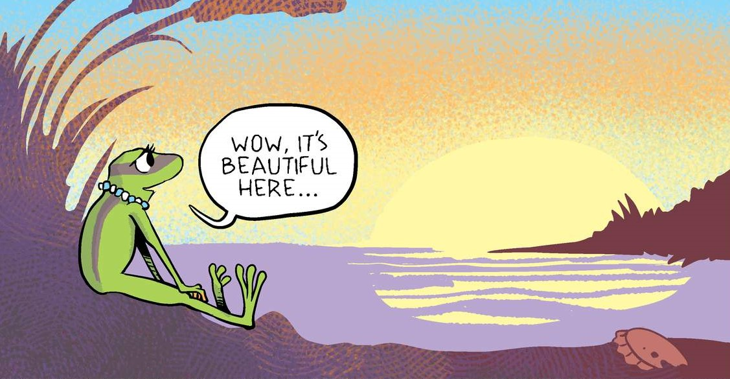
Thoughts
We start by reading that Misty has gained her first Orange spot when she thinks about how beautiful the pond is. Bull starts to follow suit by fly fishing. Bull says he will do whatever it takes. After working hard to bring social interaction, SEVERAL frogs wake with a spot. There is a huge turning point. The frogs are primarily Orange, and while the Herons are still terrifying, they find the frogs new spots dissatisfying.

Slide 6
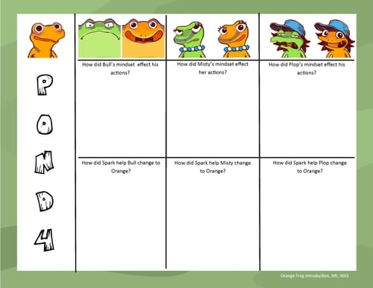
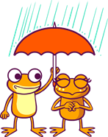
ACTIVITY
Notes:
You can either use this as a group activity and share on a projector or print out copies provided on the website for students to cut and paste the pictures on their own.

Slide 7
BONUS
When did Misty get her first orange spot?
What is the first thing Spark tells Bull to do to be more orange?
What happens after everyone eats at the “Fly by Night” together?
What do the herons decide about the frogs?

